Slide 1
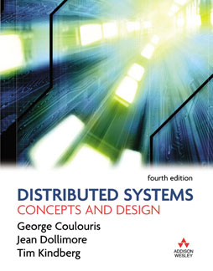
Slides for Chapter 1
Characterization of Distributed Systems
From Coulouris, Dollimore and Kindberg
Distributed Systems:
Concepts and Design
Edition 4, © Pearson Education 2005

Slide 2
Figure 1.1
A typical portion of the Internet
intranet

ISP



backbone
satellite link
desktop computer:
server:
network link:

Slide 3
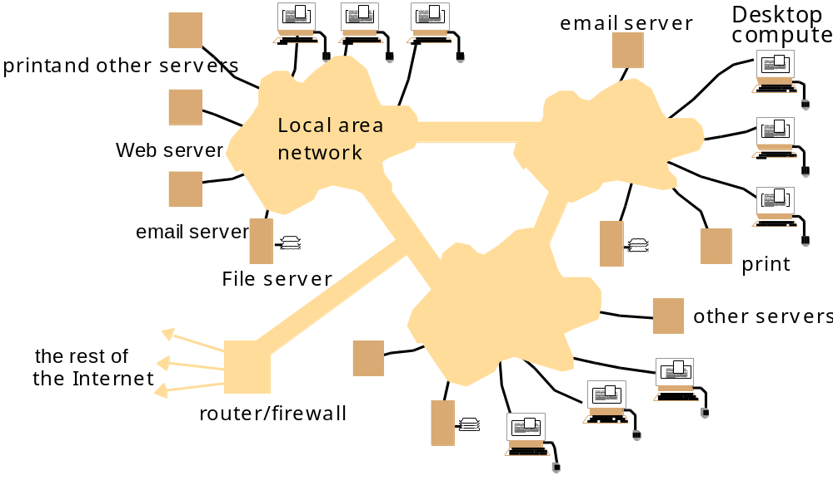
Figure 1.2
A typical intranet

Slide 4
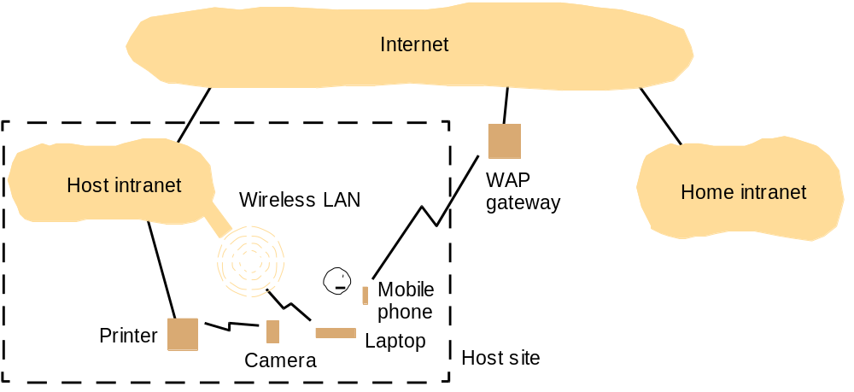
Figure 1.3
Portable and handheld devices in a distributed system

Slide 5
Figure 1.4
Web servers and web browsers
http://www.google.comlsearch?q=kindberg
www.google.com
Web servers
Browsers
www.cdk3.net
Internet
http://www.cdk3.net/
www.w3c.org
File system of
http://www.w3c.org/Protocols/Activity.html
www.w3c.org
Protocols
Activity.html

Slide 6
Figure 1.5
Computers in the Internet
Date
Computers
Web servers
1979, Dec.
188
0
1989, July
130,000
0
1999, July
56,218,000
5,560,866
2003, Jan.
171,638,297
35,424,956

Slide 7
Figure 1.6
Computers vs. Web servers in the Internet
Date
Computers
Web servers
Percentage
1993, July
1,776,000
130
0.008
1995, July
6,642,000
23,500
0.4
1997, July
19,540,000
1,203,096
6
1999, July
56,218,000
6,598,697
12
2001, July
125,888,197
31,299,592
25
42,298,371

Slide 8
Section 1.4.7
Transparencies
Access transparency: enables local and remote resources to be accessed using identical operations.
Location transparency: enables resources to be accessed without knowledge of their physical or network location (for example, which building or IP address).
Concurrency transparency: enables several processes to operate concurrently using shared resources without interference between them.
Replication transparency: enables multiple instances of resources to be used to increase reliability and performance without knowledge of the replicas by users or application programmers.
Failure transparency: enables the concealment of faults, allowing users and application programs to complete their tasks despite the failure of hardware or software components.
Mobility transparency: allows the movement of resources and clients within a system without affecting the operation of users or programs.
Performance transparency: allows the system to be reconfigured to improve performance as loads vary.
Scaling transparency: allows the system and applications to expand in scale without change to the system structure or the application algorithms.

